Slide 1
Going Live

Slide 2
Objectives
In todays class we will…
Recap the basic topics covered to date
Offer a conceptual introduction to CSS reset and downloadable style sheets
Work with Google Developer tools for site inspection
Utilize Github Pages for website deployment

Slide 3
A Few Admin Things…

Slide 4
Instructor Feedback
Remember, Homework #1 is due on Saturday, October 6 at 12:59pm.
Homework Link: https://nu.bootcampcontent.com/NU-Coding-Bootcamp/NUEVA201809FSF4/blob/master/homework%20assignments/01-week/recommended-homework-assignment.md
Remember to submit Homework via GitHub (& GitHub Pages):
https://www.bootcampspot.com/videos/watch/n167oyB7mFo
And seriously!
Submit whatever you have! Don’t get a 0.
(Even if you don’t like what you’ve made.)

Slide 5
Office Hours + Additional Help
Also, remember….
In Class Office Hours: 45 minutes before class, 30 minutes after.
Review In Class Material (Exercises and Slides):https://nu.bootcampcontent.com/NU-Coding-Bootcamp/NUEVA201809FSF4/tree/master/activities/02-week
Re-Watch Class Videos:
https://www.bootcampspot.com/sessions

Slide 6
Recapping CSS

Slide 7
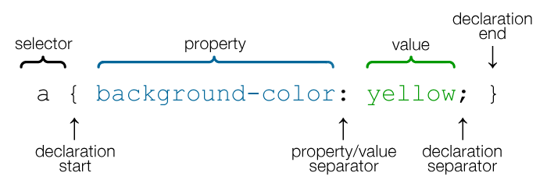
CSS Syntax
CSS works by hooking onto selectors added into HTML using “classes and identifiers”.
Once hooked, we apply styles to those HTML elements using CSS.

Slide 8
Selectors
Element selector
Applies to all <p> elements
p {
background-color: blue;
}
Applies to all elements with class=“classItem"
.classItem {
background-color: orange;
}
Applies to all elements with id=“idItem"
#idItem {
background-color: green;
}
Element name
(p, a, div, span, etc)
Class Selector
Period (.) + variable name
(.myDiv, .phoneNumber, etc.)
ID Selector
Hash (#) + variable name
(#myDiv, #phoneNumber)

Slide 9
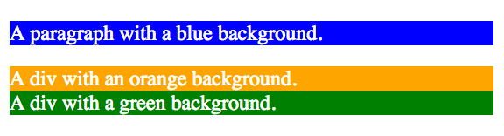
CSS Selectors
p {
background-color: blue;
}
.classItem {
background-color: orange;
}
#idItem {
background-color: green;
}
<p>
A paragraph with a blue background.
</p>
<div class=“classItem">
A div with an orange background.
</div>
<div id=“idItem">
A div with a green background.
</div>
+

Slide 10
CSS Example
In the below example the “Header” would be turned blue and MUCH larger because of the CSS.
We can incorporate an element’s class or ID to apply a CSS style to a particular part of the document.
Just remember to include the necessary symbol before the CSS: “.” for class, “#” for ID.
Example (HTML):
<p class=“bigBlue”>Header</p>
Example (CSS):
.bigBlue
{
font-size: 100px;
color: blue;
}

Slide 11
Key CSS Attributes
Font / Color:
color: Sets color of text.
font-size: Sets size of the font.
font-style: Sets italics.
font-weight: Sets bold.
Alignment / Spacing:
padding (top/right/bottom/left): Adds space between element and its own border.
margin (top/right/bottom/left): Adds space between element and surrounding elements.
Border(thickness/type/color)
float: Forces elements to the sides, centers, or tops.
Background:
background-color: sets background color.
background-image: sets background image.

Slide 12
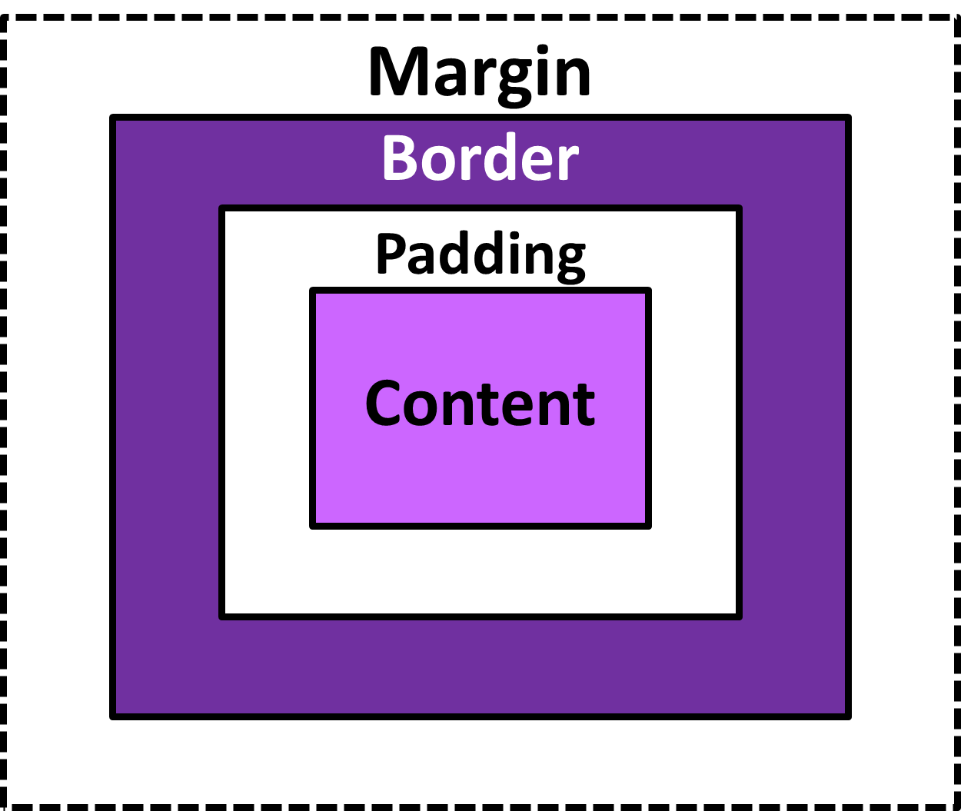
The Box Model
The Box Model wraps every CSS element in padding, border and margin – allowing developers to modify spacing styles.

Slide 13
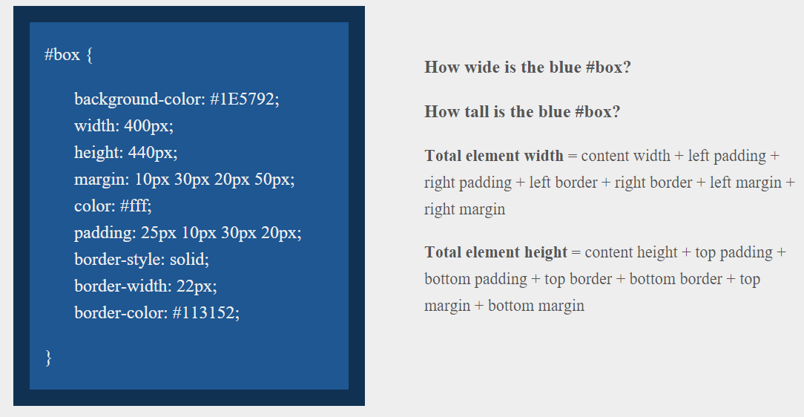
> YOUR TURN!!
Answer
Width: 474 px (no margin), 554 px (with margin)
Height: 539 px (no margin), 569 px (with margin)

Slide 14
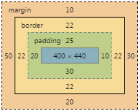
> YOUR TURN!!
Answer
Width: 474 px (no margin), 554 px (with margin)
Height: 539 px (no margin), 569 px (with margin)

Slide 15
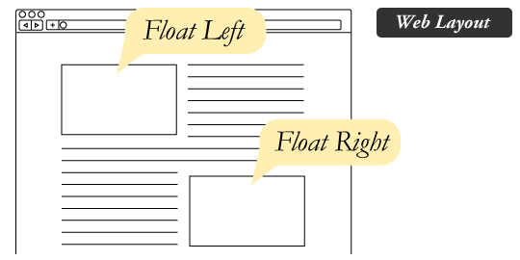
The Concept of “Flow”
In HTML/CSS, (by default) every element displayed is governed by a concept called “flow.”
This means that HTML elements force their adjacent elements to flow around them.

Slide 16
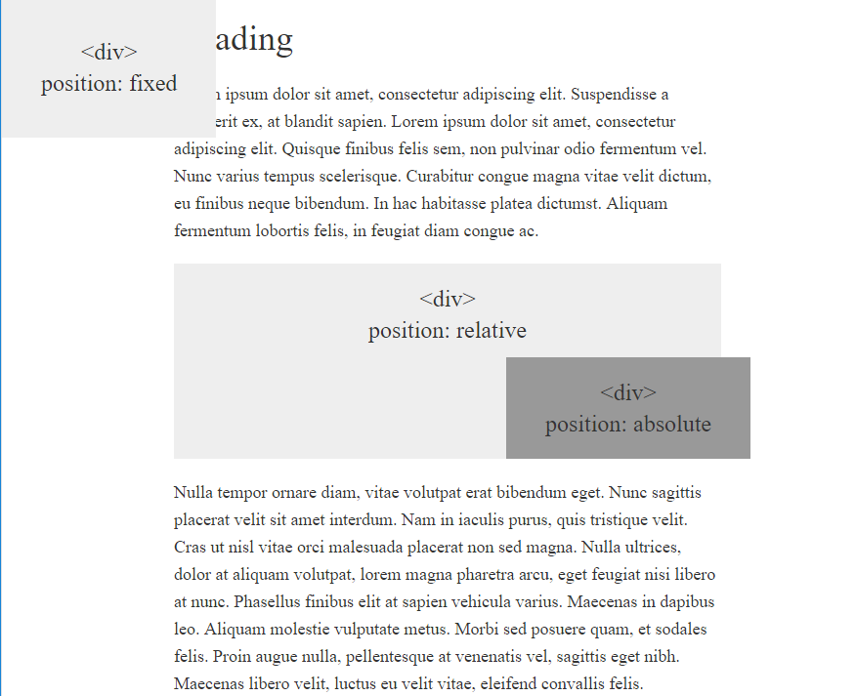
CSS Positioning
We can orient our HTML elements in relation to space with CSS positioning (static, relative, fixed, absolute).

Slide 17
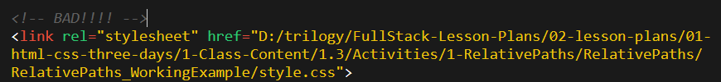

Absolutely No Absolute Paths
VERY VERY BAD
ALWAYS USE RELATIVE FILE PATHS.
If you deploy your sites without them, all of your links will fail.
The same will happen if you move your project from one folder to another.
Remember, there is no such thing as a “C:” drive on the internet.

Slide 18
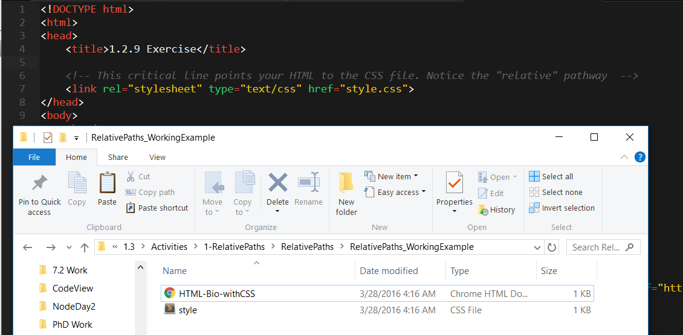
Relative File Paths
Relative file paths connect us with other files in our working directory. In this case, style.css is in the same folder as our html document.

Slide 19
Double Take

Slide 20
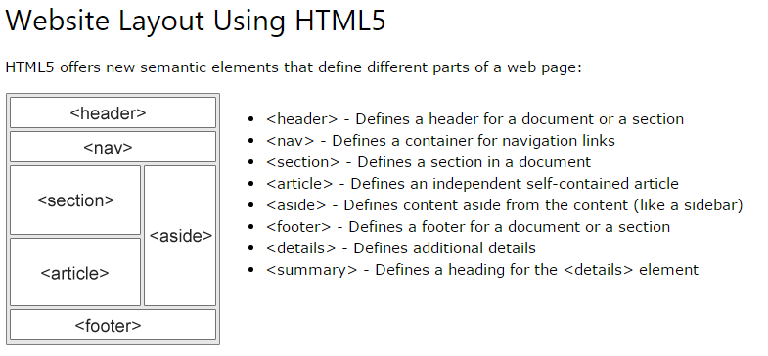
Divs, Sections, Navs, Etc….
HTML5 introduced the concept of “semantic layouts,” meaning “divs” could be given more meaningful names.
In theory, this helps with organization and search engine optimization.

Slide 21
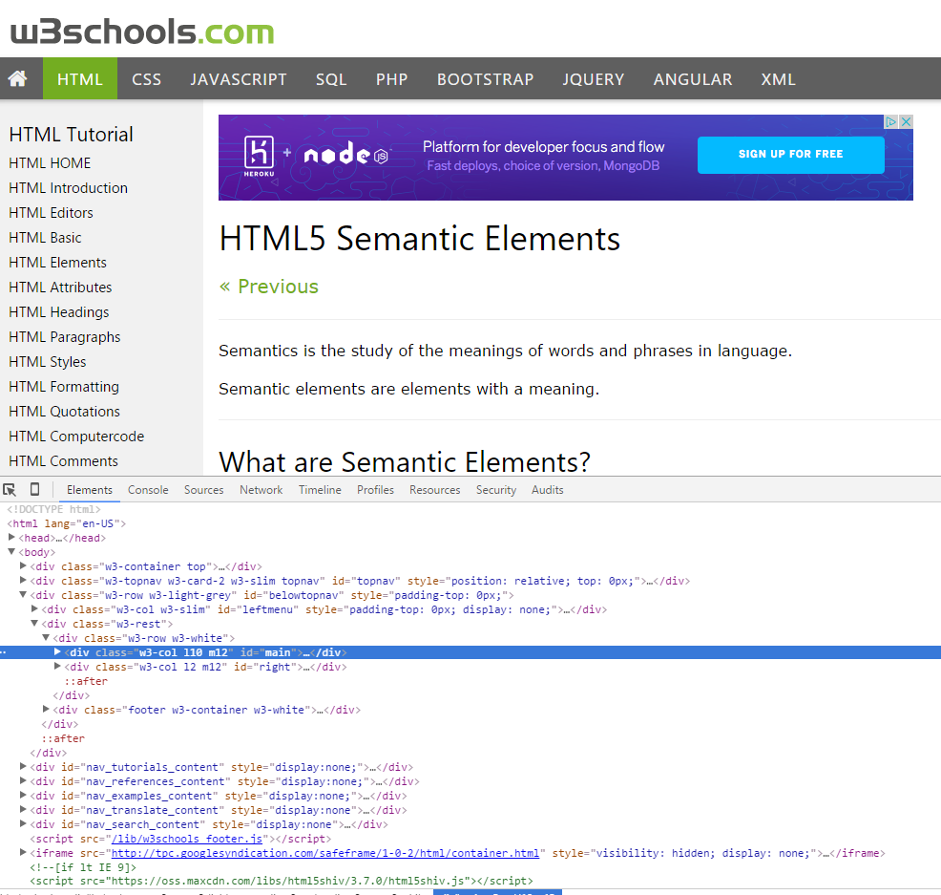
Divs, Sections, Navs, Etc….
That said… many (if not most) websites, seem to still be using basic divs.
There are reasons for this that we’ll showcase in later sections.
Additionally, it’s possible to include “semantics” by using id names and classes.

Slide 22
Divs, Sections, Navs, Etc….
div?
Section?
Bottom line: Follow your homework’s instructions. But when you get out in the “real world,” follow the convention of where you work!

Slide 23
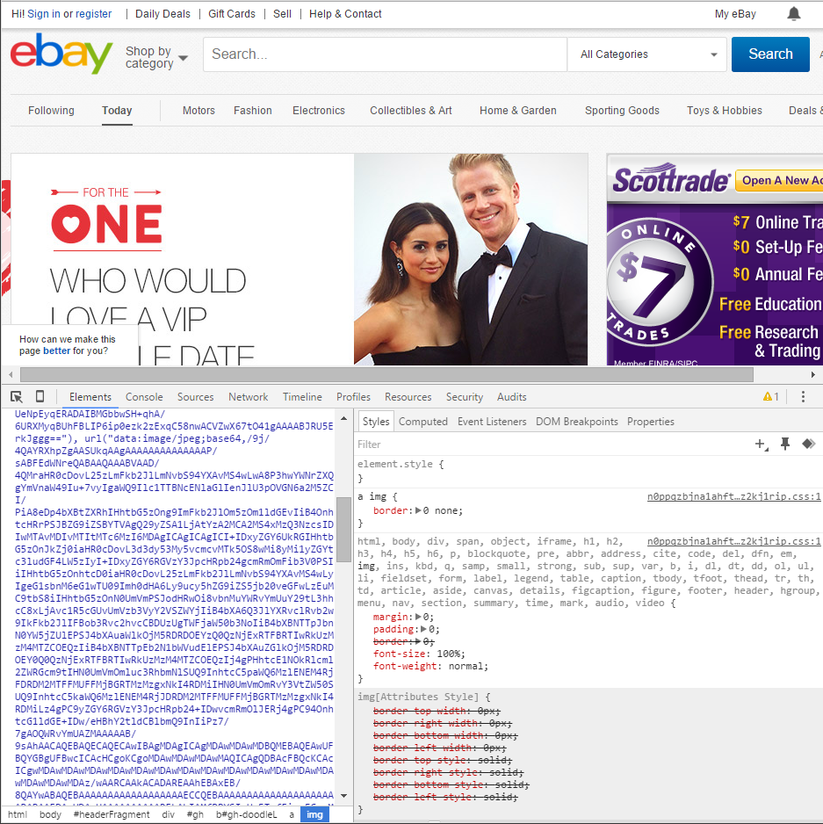
Chrome Developer Tools (Inspector)
This is one of the most frequent tools you will use in web development.
It allows you to truly debug your web designs.
Start using it!

Slide 24
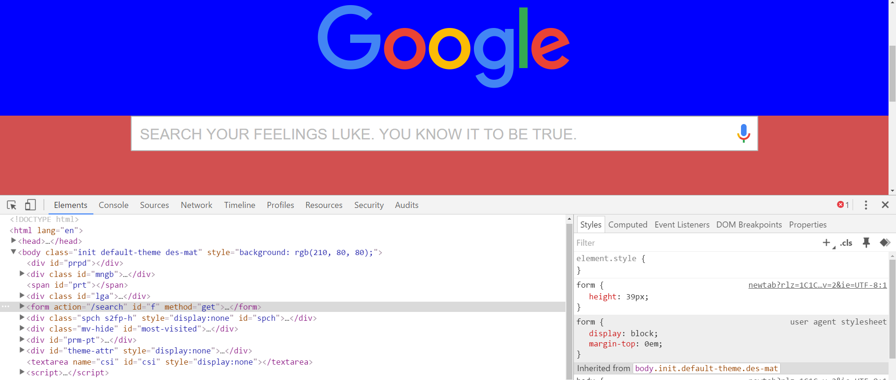
Modifying Sites
You can edit any page’s HTML and CSS with Chrome Developer Tools.
Plus, you’ll see your results instantly.

Slide 25
INSTRUCTOR DEMO!
Instructor: Demo
(Chrome Developer Tools)
Notes:
25

Slide 26
> YOUR TURN!!
Suggested Time: 15 min
Assignment
For the next 15 minutes, take a website you commonly use (Amazon, Google, Huff Po, etc.) and heavily modify it using the Chrome Developer Tools.
Be sure to at least modify:
Content (Change words)
Colors
Spacing
Send a screenshot to the class’s slack profile when you’re done.

Slide 27
> YOUR TURN!!
Suggested Time: 10 min
Assignment
For the next 10 minutes, edit any site that you’ve been working on in-class or for homework with Chrome Developer Tools.
Be sure to at least modify:
Content (Change words)
Colors
Spacing

Slide 28
CSS Resets

Slide 29
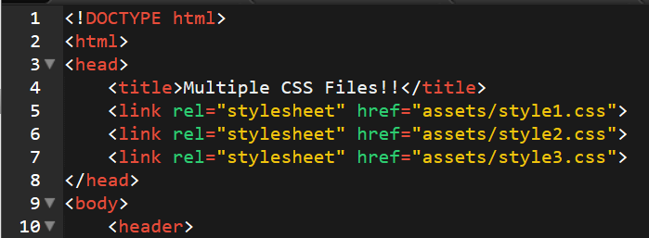
Loading Multiple CSS Files ***(Very Important!!!)***
An incredibly powerful technique: deploying multiple CSS files simultaneously.
This lets developers to create complex designs made up of abounding design elements.
Just remember: the loading order matters!!!

Slide 30
INSTRUCTOR DEMO!
Instructor: Demo
(1-3_CSSFiles.html | 3-MultipleCSS)
Notes:
30

Slide 31
What Browser?
By a show of hands…
Which browser do you use?

Slide 32
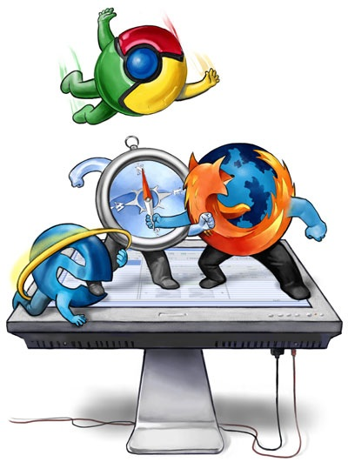
Battle of the Browsers
Under the hood, web browsers often render web pages differently than their competition.
These disparities could mean HTML/CSS displaying differently in each web client.
Because of these potential divergences, web developers need to make their websites cross-browser compatible.

Slide 33
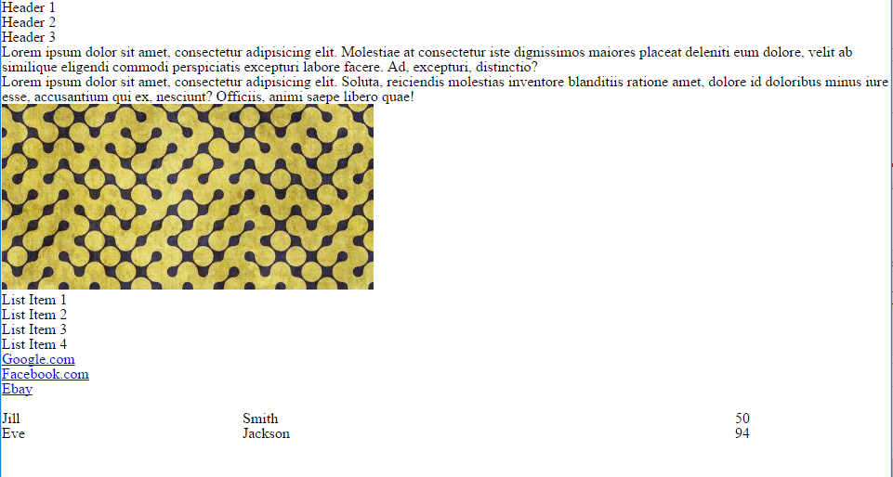
Reset.css (or Normalize.css)
Reset.css will “reset” all browser-specific CSS. This means your site will appear the same in all browsers.
However, you will have to re-style everything yourself.

Slide 34
INSTRUCTOR DEMO!
Instructor: Demo
(Example.html | 4-ResetCSS)
Notes:
34

Slide 35
Why CSS Resets Matter
It’s important for creating browser-compatible websites
It’s an example of using someone else’s CSS in your website!!!
It’s a common Front-End Developer Interview question.

Slide 36
> YOUR TURN!!
Suggested Time: 10 min
Assignment
Follow the instructions given via Slack to incorporate a reset.css file into a basic HTML file.
Note the impact the reset file makes after its inclusion.

Slide 37
To the Web with GitHub!

Slide 38

The Internet
A deep and complex diagram above on how the internet works.

Slide 39
The World Will See Our Greatness!
GitHub provides hosting for static websites – which means we can deploy our websites and applications onto their servers for the world to see.

Slide 40
Together Now…
Let’s all login to GitHub

Slide 41
INSTRUCTOR DEMO!
Instructor: Demo
(GitHub Pages Deployment - Personal)
Notes:
41

Slide 42
Deploying Static Personal Site – GitHub Pages
Basic Steps:
Create a new repo that is named `_username_.github.io`
Navigate into a folder and clone the repo into it
Build your files
Add, commit, and push your changes into the repository

Slide 43
> YOUR TURN!!
Suggested Time: 15 min
Assignment
Time to take your newfangled website and deploy it to the cloud (in this case, GitHub Pages).
Additional instructions to be sent via Slack.

Slide 44
INSTRUCTOR DEMO!
Instructor: Demo
(GitHub Pages Deployment - Project)
Notes:
44

Slide 45
Deploying a Static Project Site – GitHub Pages
Basic Steps:
1. Create a new repository on your GitHub account. You can name this repository whatever you would like.
2. Once inside of the repository, create a new file and name it `index.html`
3. Add some very basic HTML into this file, save it, and then navigate into your repository's Settings tab.
4. Scroll down to the GitHub Pages section and then, in the section labeled "Source", select that you would like to use the master branch as your source.
5. Navigate to `<username>.github.io/<repositoryname>` and you will find that your new web page has gone live!

Slide 46
> YOUR TURN!!
Suggested Time: 15 min
Assignment
Build a newfangled website, and deploy it to GitHub Pages as a project instead of a personal site.
Additional instructions to be sent via Slack.

Slide 47
Practice Through Frustration
Keep Practicing!
It gets better.

Slide 48
Questions?

Slide 49
Homework 1 - Help?

Slide 50
EXTRA MATERIAL

Slide 51
And Back to Git…

